Slide 1
Angular Data Binding
Different Ways of Connecting Variables

Slide 2

Introduction to Angular
What is Angular?
A popular web development framework for building client-side applications.
Developed and maintained by Google.
Key Features of Angular:
Component-based architecture.
Two-way data binding.
Dependency injection, etc.

Slide 3
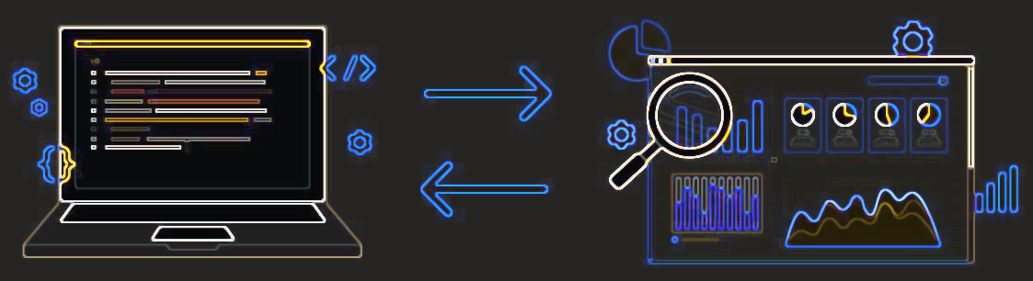
What is Data Binding in Angular?
Definition:
Data Binding is a mechanism in Angular that provides synchronization between the model (data source) and the view (UI).
Importance:
Makes development simpler and more interactive.
Reduces the need for direct DOM manipulation.

Slide 4
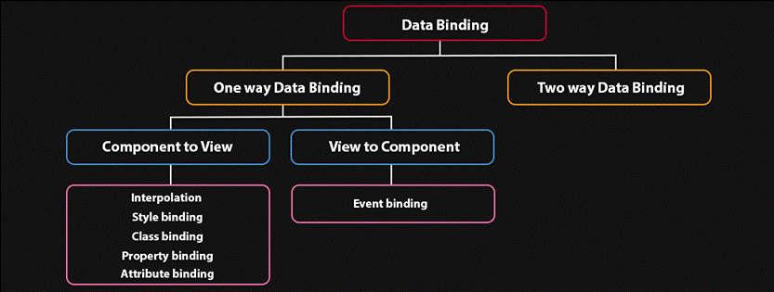
Types of Data Binding in Angular
One-way Data Binding:
Interpolation
Property Binding
Event Binding
Two-way Data Binding

Slide 5

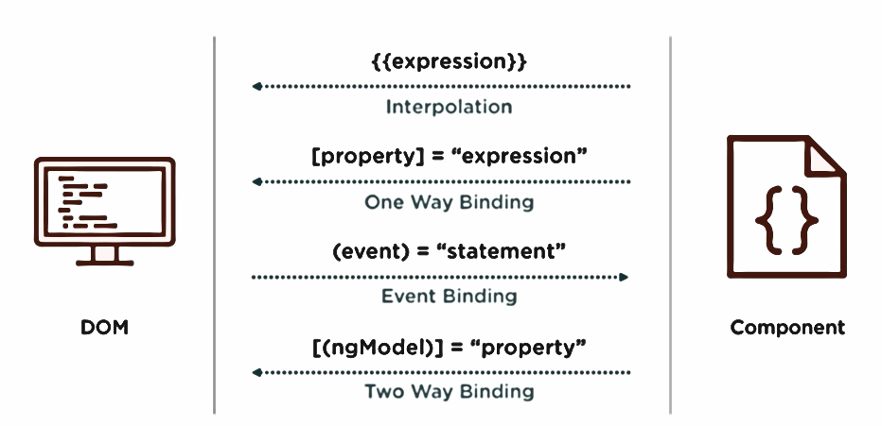

Interpolation (One-way Binding)
Definition:
Used to bind data from a component to the view.
Syntax:
<html-tag>{{ variableName }}</html-tag>
Example:
<h1>{{ title }}</h1>
<p>Hello, {{ userName }}!</p>

Slide 6
Property Binding (One-way Binding)
Definition:
Allows binding of element properties (such as DOM properties) to the component.
Syntax:
<html-tag [property-name]=“variableName">
Example:
<img [src]="imageUrl">
<button [disabled]="isDisabled">Click Me</button>

Slide 7
Event Binding (One-way Binding)
Definition:
Used to listen for user events such as clicks, key presses, etc., and trigger the component methods.
Syntax:
<html-tag (event)=“functionName()">Click Me</html-tag>
Example:
<button (click)="onClick()">Click Me</button>
<input (keyup)="onKeyUp($event)">

Slide 8
Two-way Data Binding
Definition:
Combines both property binding and event binding in a single process.
Allows changes in the component to be reflected in the view and vice-versa.
Syntax:
<input [(ngModel)]=“variableName">
Example:
<input [(ngModel)]="userName">
<p>Welcome, {{ userName }}!</p>

Slide 9
One-way v/s Two-way Binding
Feature
One-way Binding
Two-way Binding
Data Direction
Use Cases
Examples
Component → View
Displaying data
Interpolation, Property binding
Component ↔ View
Forms, interactive elements
[(ngModel)]

Slide 10
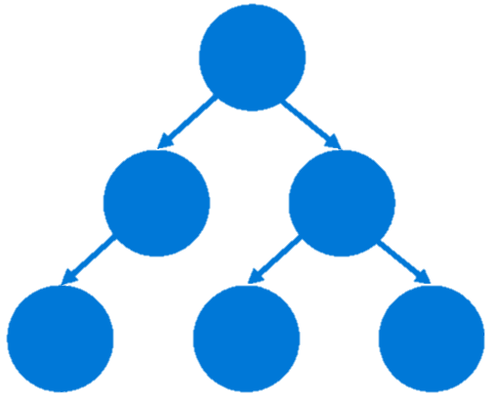
Benefits of Angular Data Binding
Simplifies the code by reducing manual DOM manipulation.
Enhances the interactivity of applications.
Ensures consistent updates across the application when data changes.
Suitable for building reactive applications.

Slide 11
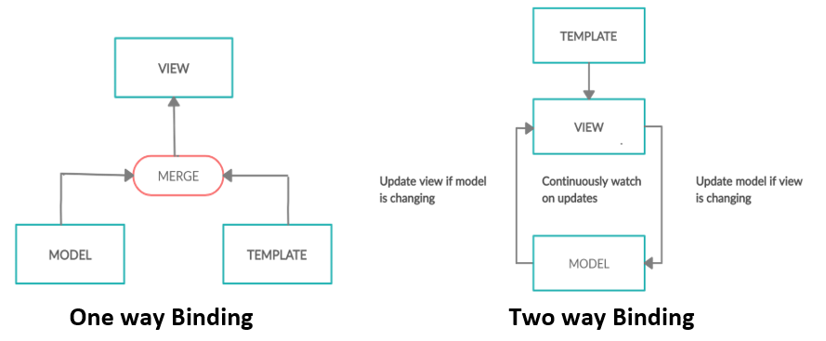
Conclusion
Angular's data binding simplifies communication between the model and view.
It provides flexibility with different types of binding for various use cases.
Two-way data binding is highly useful in forms and user input.

Slide 12
Thank You! Under the Guidance of Indrakka Mam Edubridge * Capgemini - Shridhar Pandey

